Slide 1
Launch Pad Monitoring system
Advanced Interaction Media
HCDi
Nikhil Badri
Research Assistant
Notes:
Different Interaction ways for a single device.

Slide 2
AIM
Enhancing the tangible interaction of the rocket monitoring system
An interactive “skin” for the rocket mock-up model
Operating the camera of rocket @ launch pad from the command center
Designing a touch sensitive layer over the model that acts as interaction
Notes:
Introduce previous work of Dr. Lucas work
Enhancing his work
Different skins

Slide 3
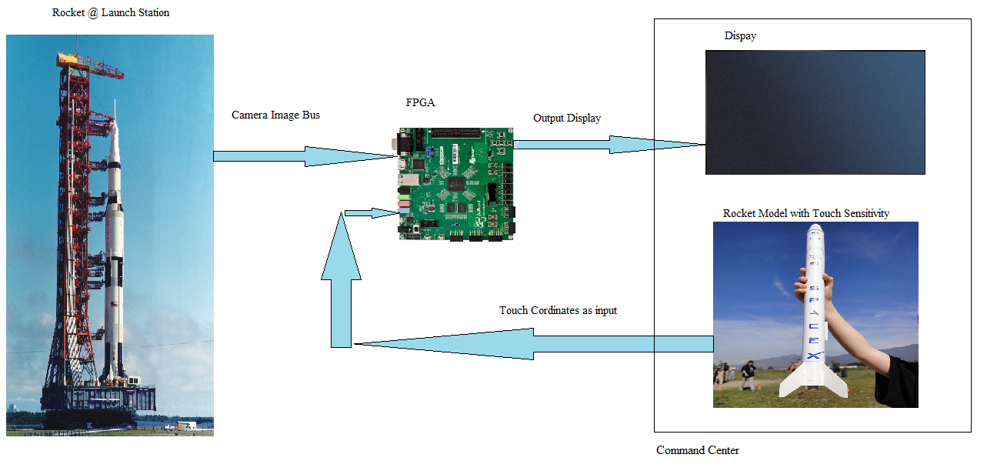
Design option 1
Notes:
1. Designing a touch sensitive layer over the model that acts as interaction
2. The touch coordinates were obtained from the touch layer
3. These coordinates can be mapped to the rocket standing at the launch pad with the help of FPGA
4. Initiating the new by camera and routing the image from it to the command center
CONS:
NO processing is required in this method and the FPGA potential cant be utilized
Gave idea of 2nd design

Slide 4
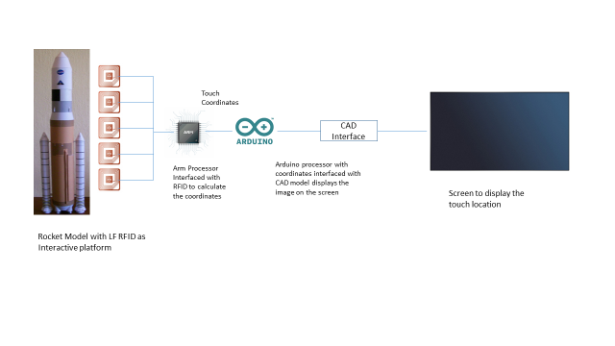
FPGA to Arduino

Slide 5
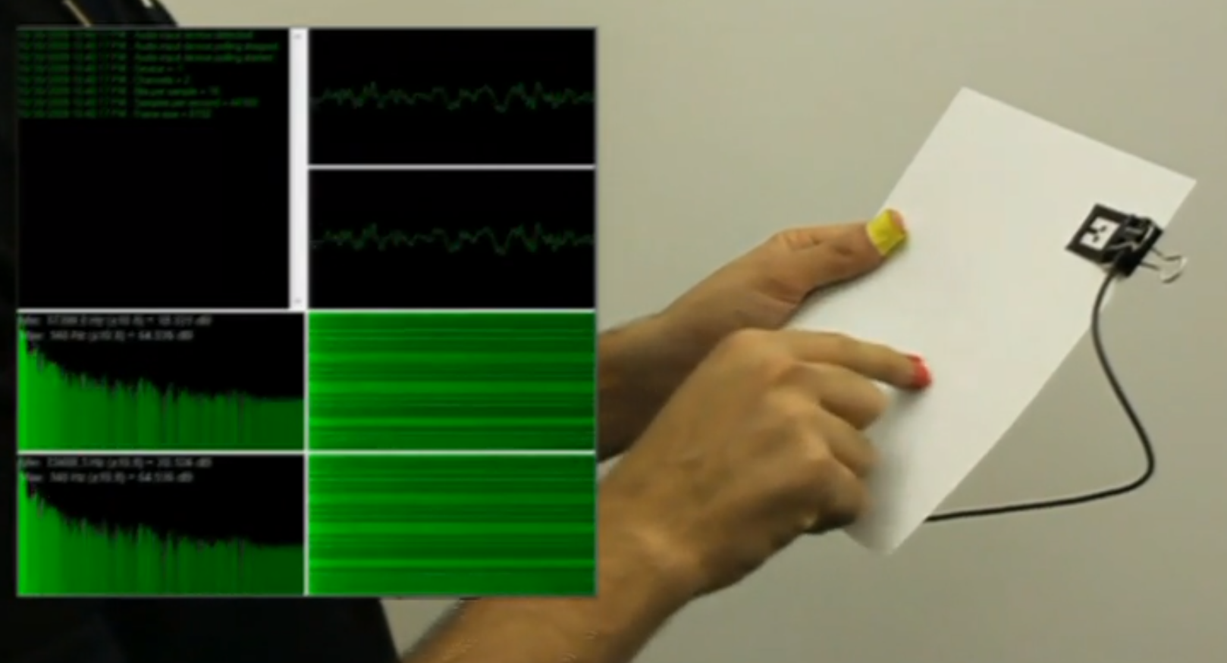
Design option 2- Sound Triangulation
Notes:
Sound triangulation using the touch intensities from the small mems microphones.

Slide 6
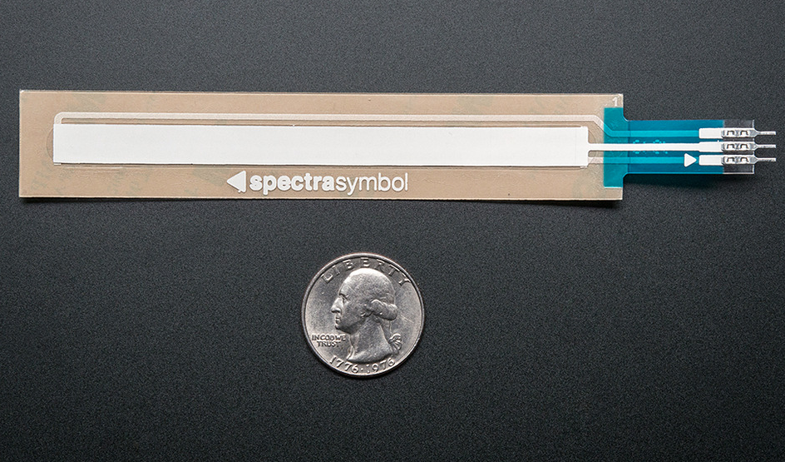
Design option 3 – Rheostat Strip
Notes:
Resistance difference gives the coordinates
But, the touch grip of the hand also makes diffrenece

Slide 7
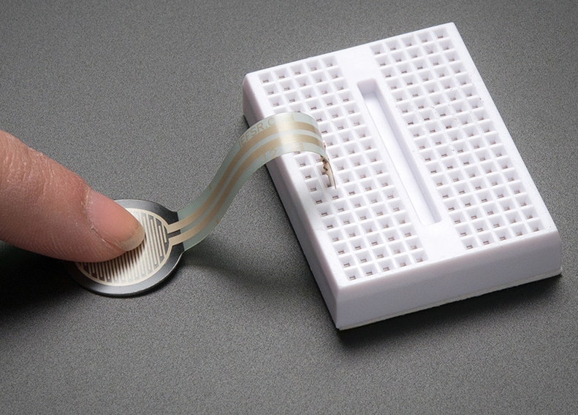
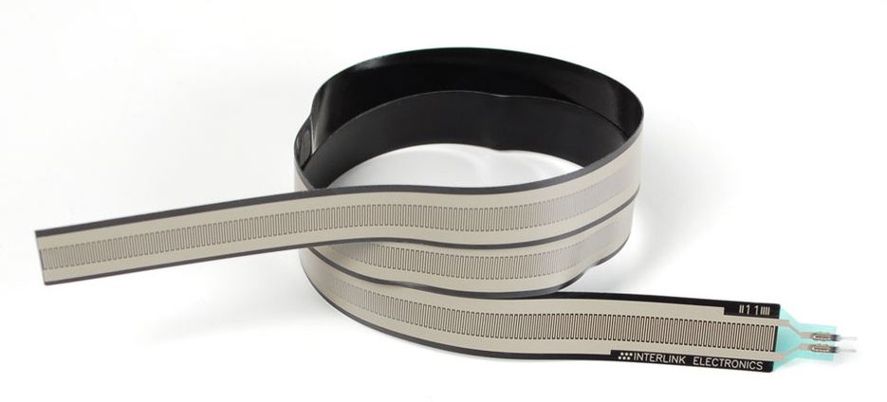
Design option 4 – Force-Sensitive Resistor
Notes:
Pressure from the touch

Slide 8

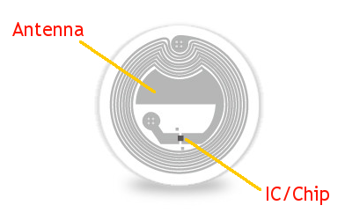
Design option 5 – RFID & NFC
Notes:
RFID & NFC

Slide 9
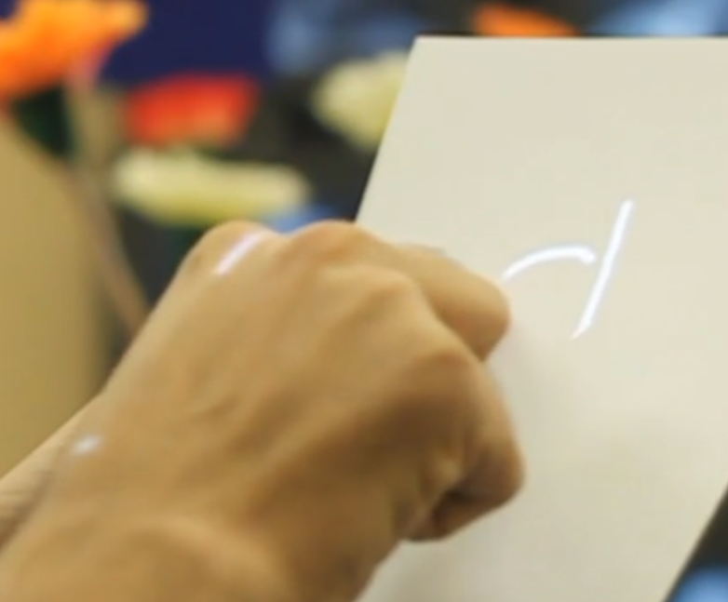
Design option 6 – Video Processing
Notes:
Static cameras detect the touch point

Slide 10
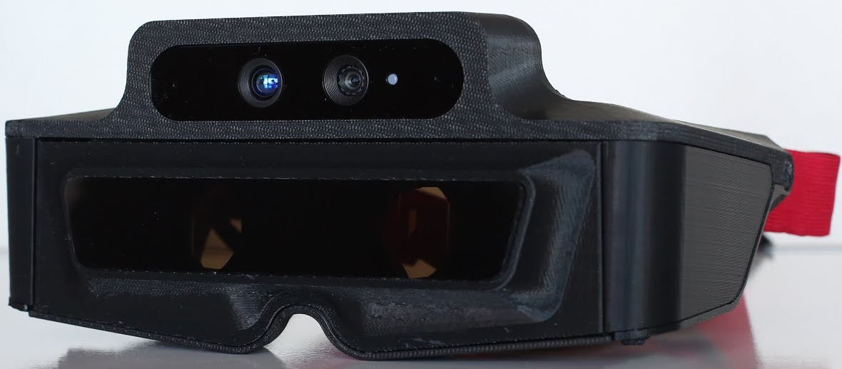


Design option 7 – Augmented reality with qr tags
Notes:
QR tags programmed with the cameras.

Slide 11
QOC
Credits -
Dr. Lucas Stephane

Slide 12
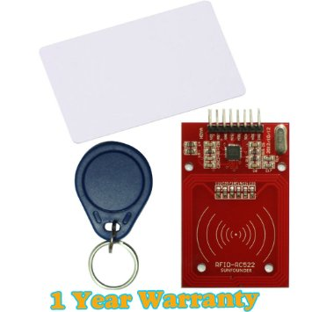
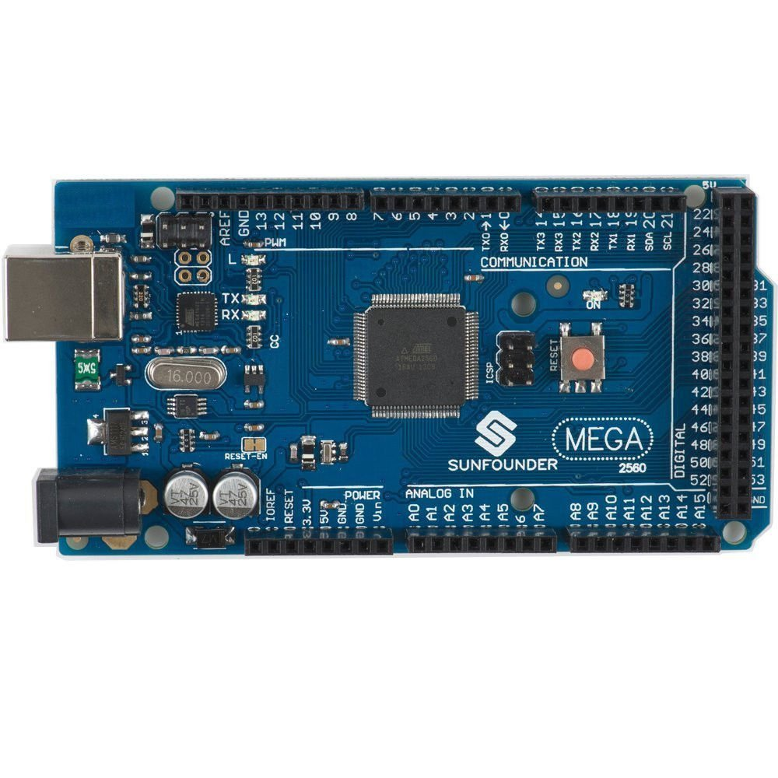
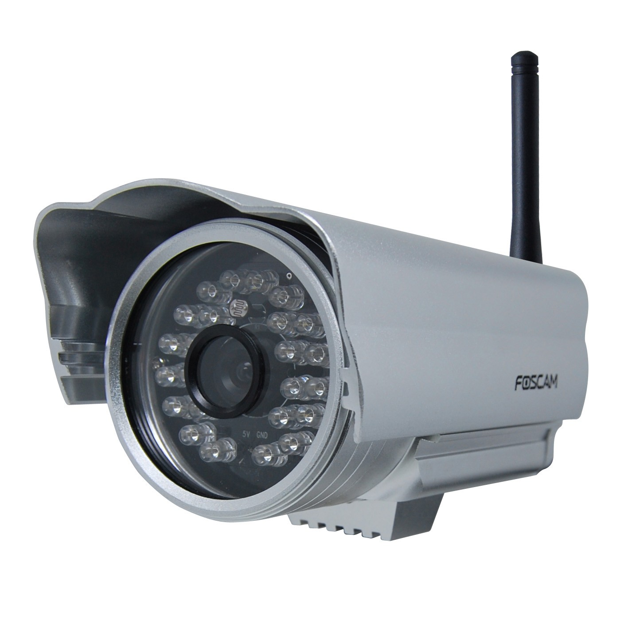
NFC, Arduino & IP cameras
Phones used instead with IPWeb Cam app

Slide 13
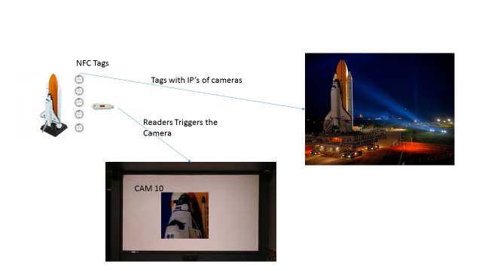
NFC – IP Camera

Slide 14
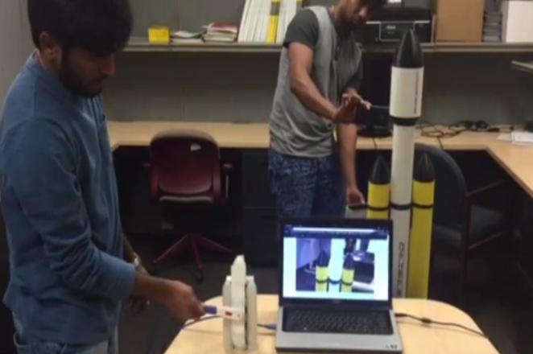
NFC & IP camera model
Notes:
Video of ip cam

Slide 15
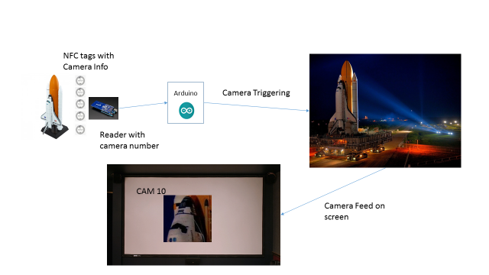
NFC - Arduino

Slide 16
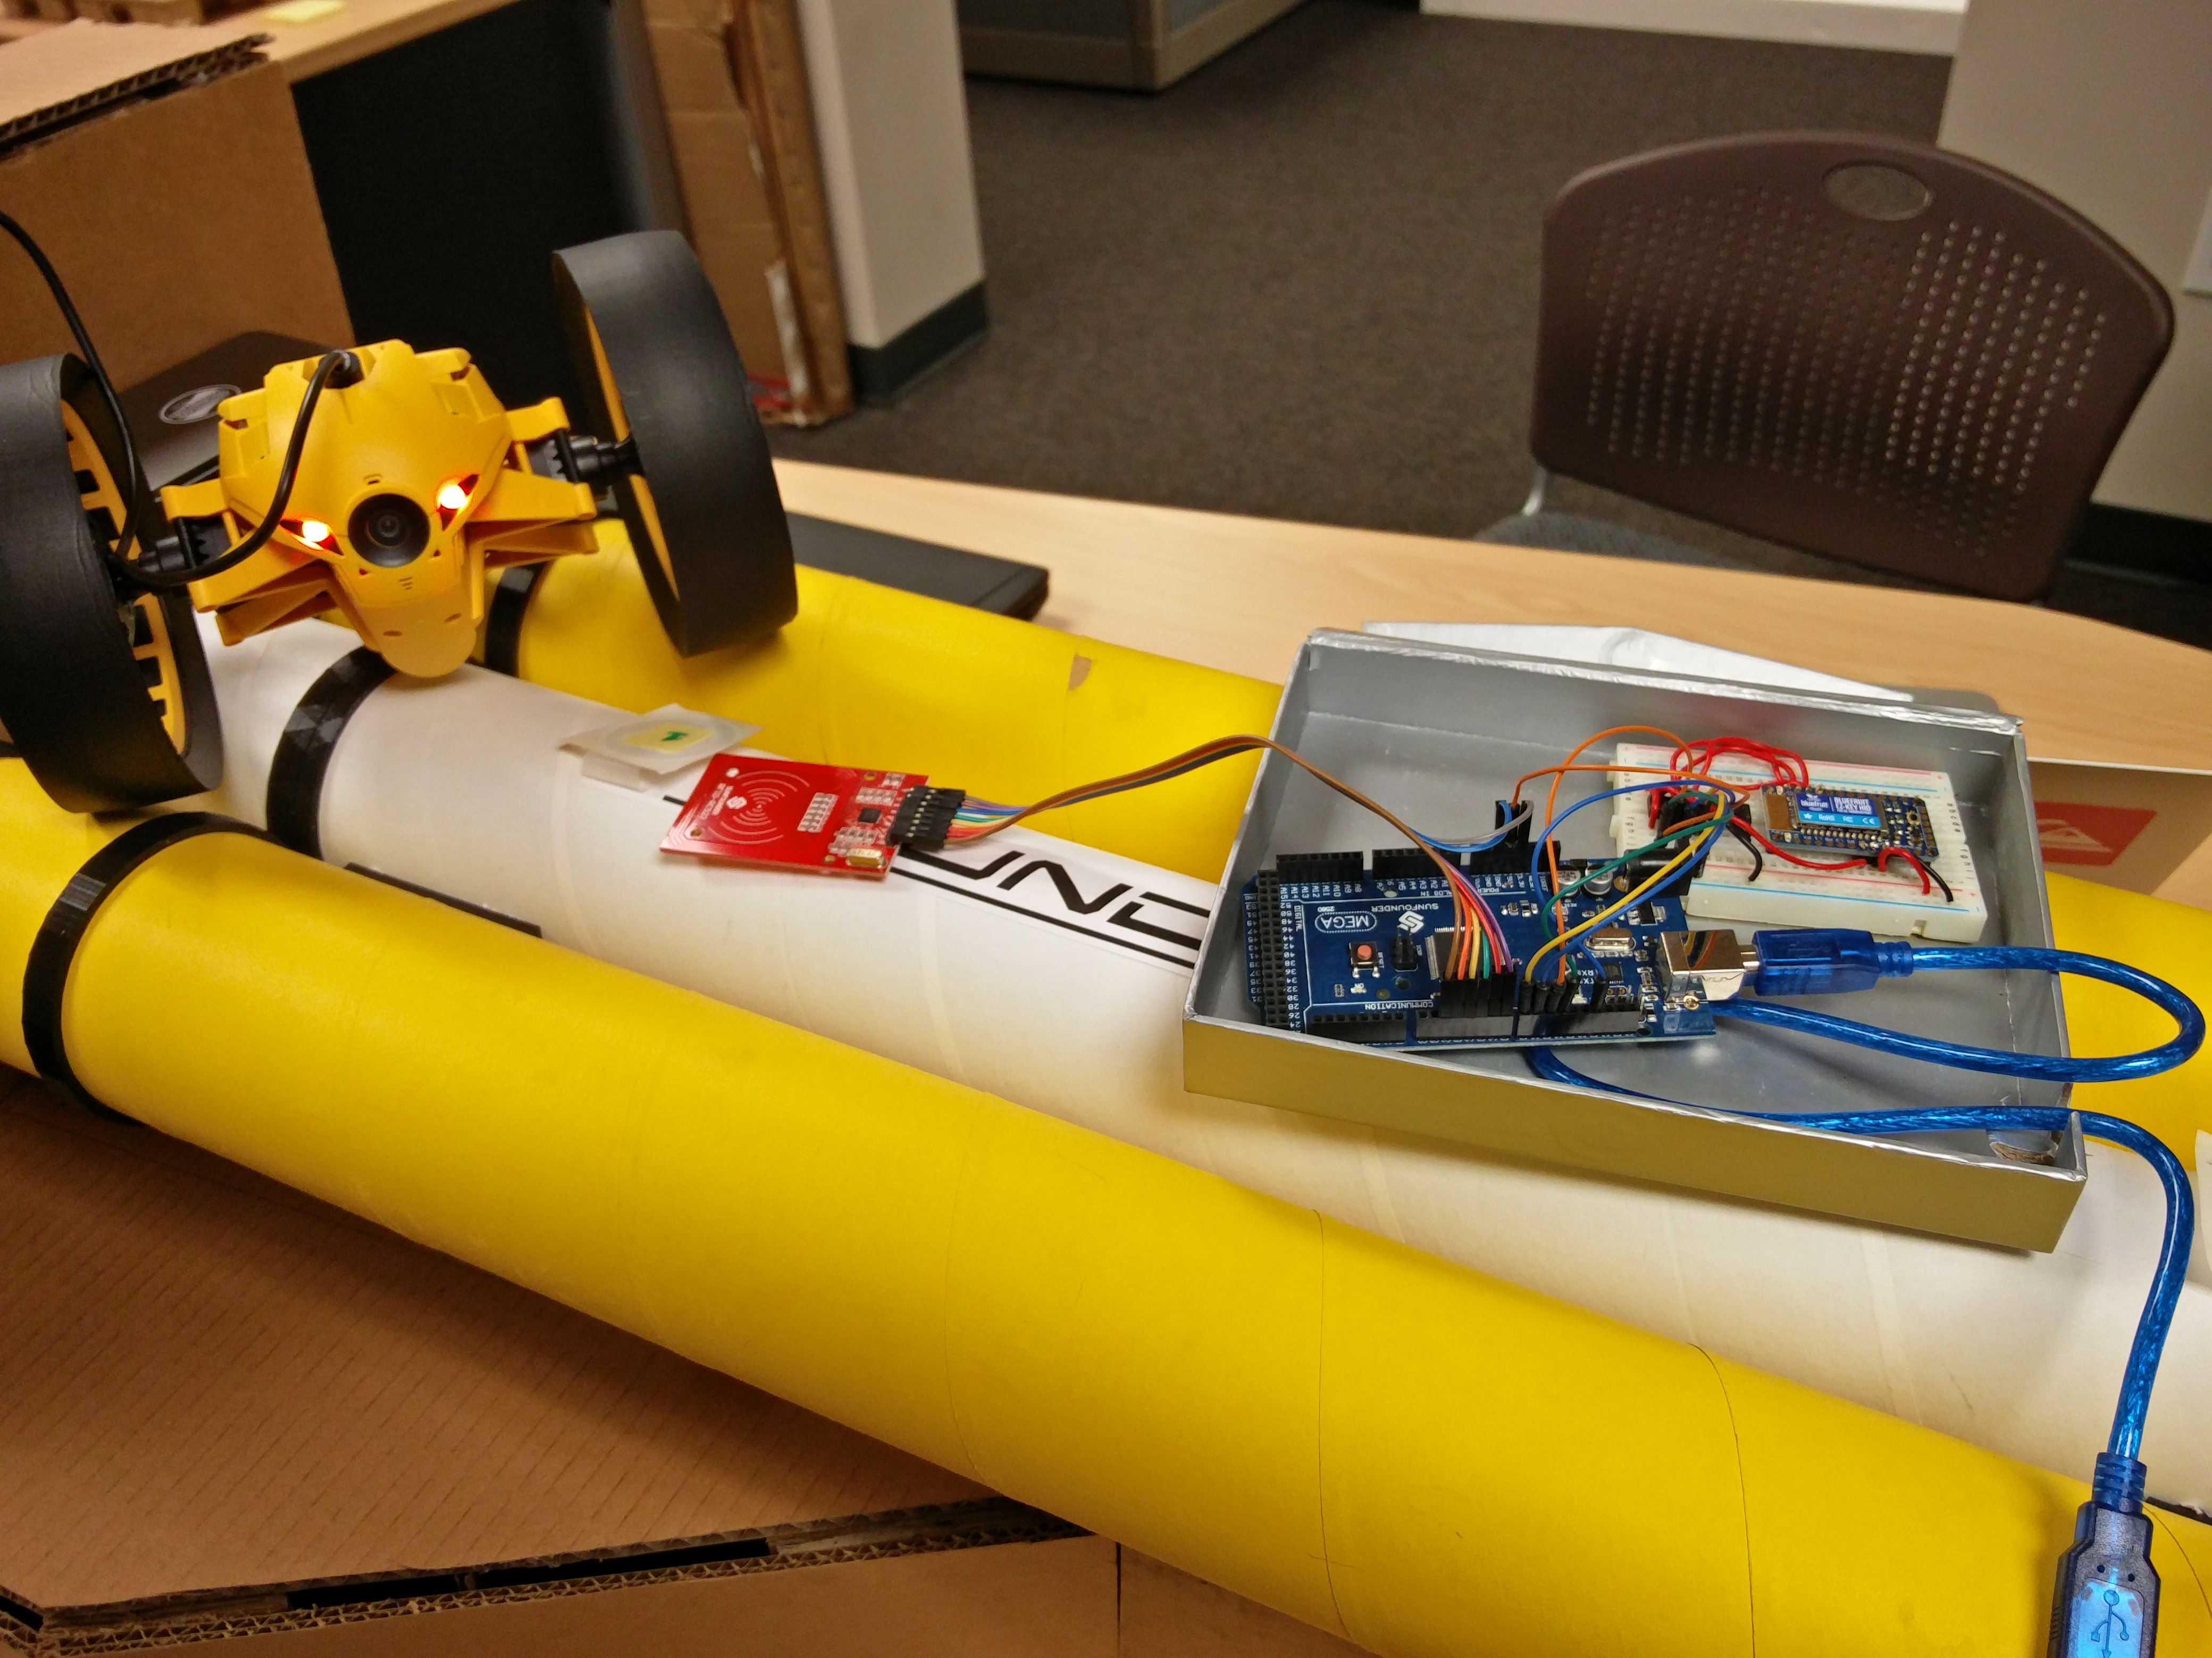
NFC & Arduino Model build-up

Slide 17
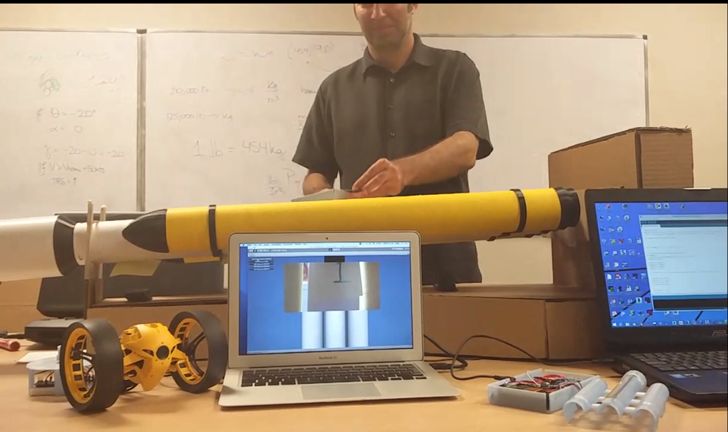
NFC & Web camera
Notes:
Video of nfc-Arduino

Slide 18
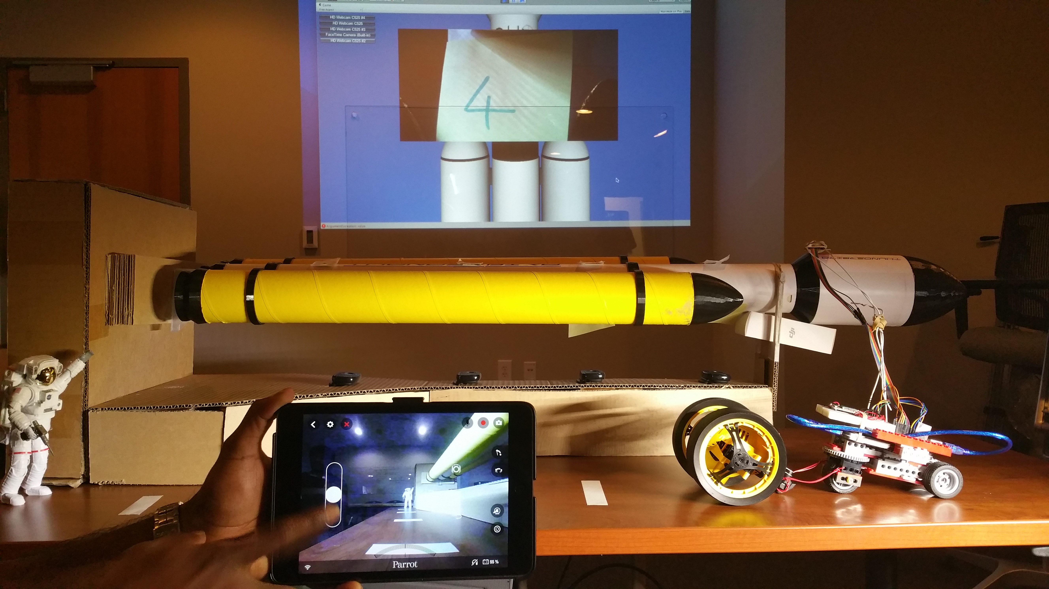
NFC & Web camera & DRONE

Slide 19
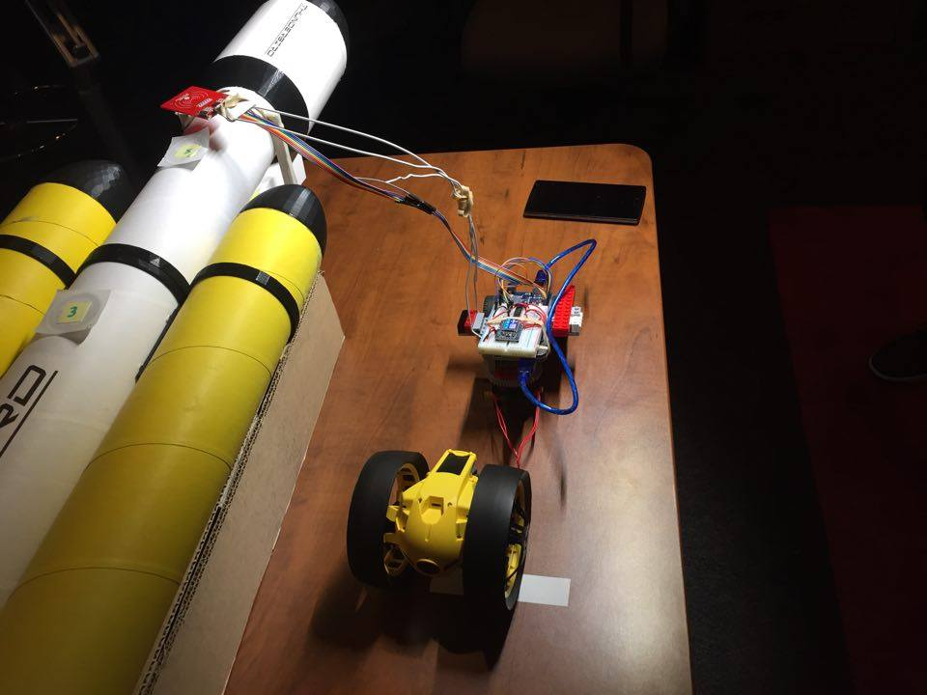
NFC & Web camera & DRONE
Notes:
Nfc drone video.

Slide 20
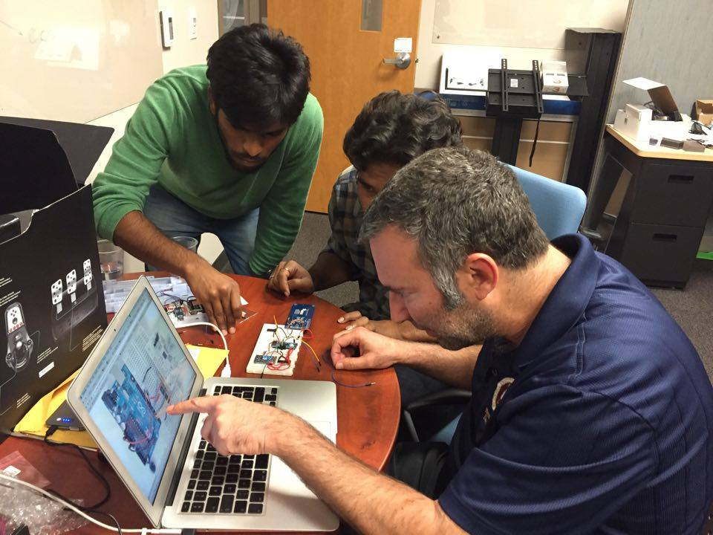
Team work @ 2 am
Photo -
Raj Nihar.

Slide 21
QUERIES ?

Slide 22
Thank You !!

